Slide 2
Objectives
Understand what is meant by cloud storage
Explain the advantages and disadvantages of storing data on the cloud in comparison to storing it locally

Slide 3


Starter
Many people and companies now use the cloud
What is the cloud?

Slide 4

The cloud
The cloud is another name for services offered via the Internet
The name comes from network diagrams that use a cloud symbol to represent the Internet
The cloud can be split into two major areas:
Cloud storage
Cloud computing
What is cloud storage?

Slide 5

Cloud storage
Cloud storage allows users to store files and data on the Internet
The files are accessed remotely by users
Data may be stored in multiple locations
A professional company will manage the data storage
What are two other cloud storage features?

Slide 6

Cloud storage features
Further features include:
Synchronisation of devices with the cloud storage
24/7 Availability
Redundancy
Multiple file versions
Only pay for storage used
Scalability
What do each of these features mean?

Slide 7

Redundancy
Storage redundancy is where multiple copies of files are stored in different locations
In local storage this is normally carried out by having multiple copies of files on two different hard drives in one server
In cloud storage the locations that store redundant files may be anywhere in the world

Slide 8

Scalability
Scalability is the ability of the storage system or cloud computing resources to increase in size
A home PC doesn’t have scalable storage. It may be possible to have two or three hard disks, but not two or three hundred
Cloud storage normally charges for the amount of storage used
Increasing offline storage usually requires the purchase of new disks

Slide 9
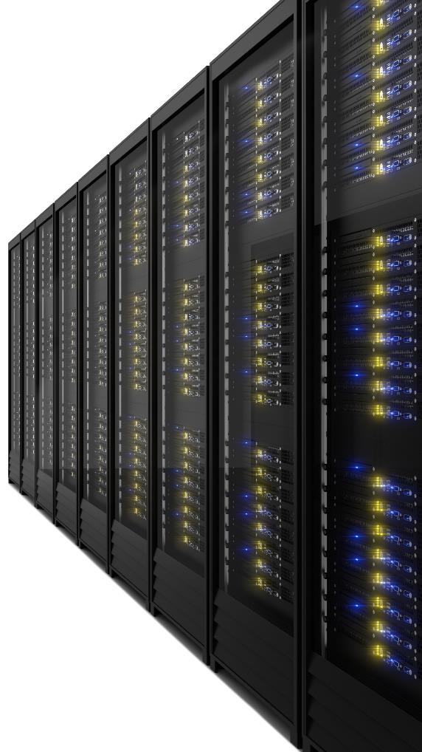
Data centres
Data centres are buildings that are dedicated to storing physical servers
Each server will contain an array of hard drives
Professional engineers will manage the computers
The buildings will have temperature control and air conditioning
Uptimes for data centres are often better than 99.99%

Slide 10
Worksheet 6
Complete Task 1 and Task 2 on Worksheet 6

Slide 11

Privacy
If data is stored in the cloud, the security and privacy of the data is controlled by an external company
Data stored locally is under the control of a single person or organisation
Both cloud storage and local storage may be hacked, however, typically cloud storage will be more secure
Companies and organisations will need to consider the level they trust an external company to hold their data

Slide 12
Data transfer speeds
When a file is used that is on cloud storage it must first be downloaded
With a fast connection and a small office document this may happen in a few seconds
However, with files such as those used in video editing it may take hours to open or save files to cloud storage
Local storage is very fast to transfer data
A local SATA solid state drive can read and write data at around 500 MB per second
A typical UK internet connection operates at around 70 Mb/s giving speeds of less than 10 MB per second

Slide 13
Worksheet 6
Complete Task 3 on Worksheet 6

Slide 14

Plenary
Work in a pair to answer the following questions:
What is cloud storage?
How does it differ from local storage?
What are two advantages and disadvantages of cloud storage compared to local storage?

Slide 15
Plenary
What is cloud storage? Remote storage provided by a company that is bought as a service
How does it differ from local storage? Local storage consists of hard drives that are owned and maintained by the user or organisation themselves
What are two advantages and disadvantages of cloud storage compared to local storage? Some suggestions:
Cloud storage advantages | Cloud storage disadvantages
Redundancy in many remote locations | Takes longer to download data in the case of a full restore
Managed by the cloud storage provider | Not appropriate for large files where quick access is needed

